Slide 1


CAP for Mobility Support
Yuanjie Li¹, Zengwen Yuan¹, Chunyi Peng², Songwu Lu¹
¹University of California, Los Angeles
²The Ohio State University
Notes:
Thanks for introduction.
In this talk, I will show some fundamental limits of mobility support in cellular networks, and some design hints of mobility support for future 5G.

Slide 2


New Mobile Services in Future 5G
Real-time virtual reality
Remote mobile healthcare
Emergency communication
Mission-critical communication
Safe autonomous driving
High-speed mobility
Notes:
We are moving toward a next-generation 5G mobile network.
We have seen that a bunch of new mobile services that will hopefully be supported by 5G, such as the real-time mobile VR, remote mobile healthcare, communication after disaster, mission-critical machine type communications, safe autonomous driving, high-speed mobility on the train, to name a few.
Although these services are very different from each other, they share the same demand for the 5G:
They want a low-latency, reliable 5G network infrastructure.

Slide 3
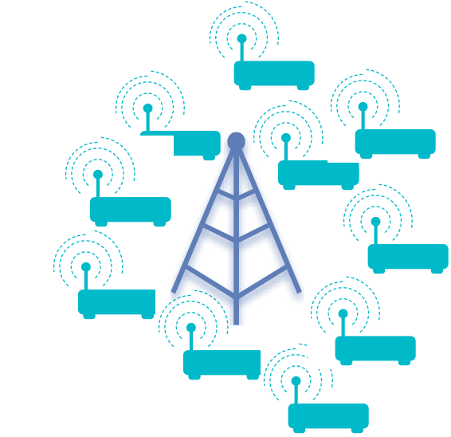
Key Enablers for 5G Mobile Services
Advanced
wireless technologies
Advanced
mobility support
Notes:
Toward this goal, two key technical enablers are very critical in 5G.
The first one, of course, is to improve the speed and reliability of the wireless connectivity.
In recent years, we have seen many exciting efforts along this direction, such as the 60GHz wireless, visible light communication, massive MIMO, interference cancellation, and dense small cell deployments.
The other dimension, is the mobility support mechanisms.
Although it is less explored, it is actually equally important to the wireless connectivity.
How should it evolve in 5G network for new mobile services?
Should we continue to use today’s mobility management mechanisms from 4G LTE, or renovate the design to support these new mobile services?
Motivated by this, we start to work on the mobility support, and seek to answer these questions.

Slide 4

Wide-Area Mobility via Cellular Networks
Cellular Networks
(e.g., 3G/4G)
...
Notes:
Let’s first look at how mobility support works today.
Today, the cellular networks such as 3G and 4G are the only large-scale wireless infrastructure that offers wide-area data service in practice.
As user moves from one location to another, it aims to offer seamless connectivity and high-quality data service to users.

Slide 5
How does Mobility Support Work in 4G LTE?
Span on multiple network nodes
Involve multiple control procedures
Internet
Data-plane
Routing update
Control-plane
Session state transfer
Location update request
User profile update
Radio conn. setup
Tracking Area 1
Tracking Area 2
Location update
accept
Notes:
The mobility support is distributed in nature.
In 4G LTE, it spans on multiple infrastructure nodes, including the base stations, the gateways, mobility controllers and user-profile databases.
For scalability of large-area mobility, 4G-LTE splits these nodes into multiple location domains called tracking areas, each of which is managed by a mobility controller and includes multiple base stations and gateways.
When the mobile device moves to a new location domain, the mobility support should resume the data service.
This triggers several micro-level control procedures, including the establishing radio connectivity, user location update, fetch user’s data session states from old location domains, update routing path between gateways and base stations, update user profile, then location update accept.
Afterwards, the user will be able to send and receive data.
In performing these control procedures, the involved network nodes should collaborate in a distributed fashion.

Slide 6

Three Expectations for Mobility Support
Immediate data service
Correct data service
Continuous data service
Once route is connected
Forward packets under right policies
Even in presence of failures
Can we always achieve all of them?
Notes:
From user’s perspective, we want the mobility support to be fast, correct and reliable.
It should provide immediate mobile data service to users once the radio and data path are connected.
It should provide correct mobile data service. For example, forward the data to right user location. only the authorized user can have data service. All user’s data should be encrypted over the air. The user should experience QoS as its data plan promises, and it should be correctly billed
The mobile user wants continuous data service, even when some failures happen.
A natural question would arise then: can we always achieve all of them simultaneously?

Slide 7
This talk
A formal analysis of fundamental limits in mobility support
  From the distributed system perspective
Fundamental limits: CAP theorem on generic mobility support
Rethink the tradeoff between different properties
  Argument: 5G needs a paradigm shift in its mobility support
Notes:
In this work, we will study this problem from the distributed system perspective.
We will show a fundamental limit exists for any mobility support design.
We proved the CAP theorem, which profoundly affected in the database community, also holds in mobility support.
Simplify speaking, if we follow have done today in 3G/4G, we can never satisfy all simultaneously.
This motivates us to rethink the traditional wisdom in the mobility design.
We will discuss the tradeoffs between these properties, and argue that the future 5G needs a paradigm shift in mobility support, and re-balance different good properties.

Slide 8
Outline
Q1: What properties do we want?
Q2: Can we achieve all properties simultaneously?
Q3: How to balance different properties?
Notes:
The rest of the talk will focus on three concrete questions

Slide 9
What properties do we want?
From mobile user demands to formalization
Notes:
Let’s first think about what properties we would expect for a mobility support.
To provide “anywhere, anytime” mobile data service to users, we would expect that this design should satisfy three properties.

Slide 10

What Properties do We Want?
Correctness: Forward every packet under correct policies
Internet
Data-plane
Control-plane
Tracking Area 1
Tracking Area 2
Notes:
First, the network should offer correct mobile data service.
Each data packet should be forwarded to the correct user location, under the radio access policy, data billing policy and QoS configurations.
Since the mobility support is distributed in nature, achieving correctness requires collaborations between network nodes, under some consistent views of mobile user status.

Slide 11
What Properties do We Want?
Correctness: Forward every packet under correct policies
  4G LTE: correctness via sequential consistency
Internet
Data-plane
Routing update
Control-plane
Session state transfer
Location update request
User profile update
Radio conn. setup
Tracking Area 1
Tracking Area 2
Location update
accept
Notes:
In 4G LTE, the correctness is guaranteed by mandating the classical sequential consistency model.
That is, all network nodes have identical view of the user data session in mobility.

Slide 12
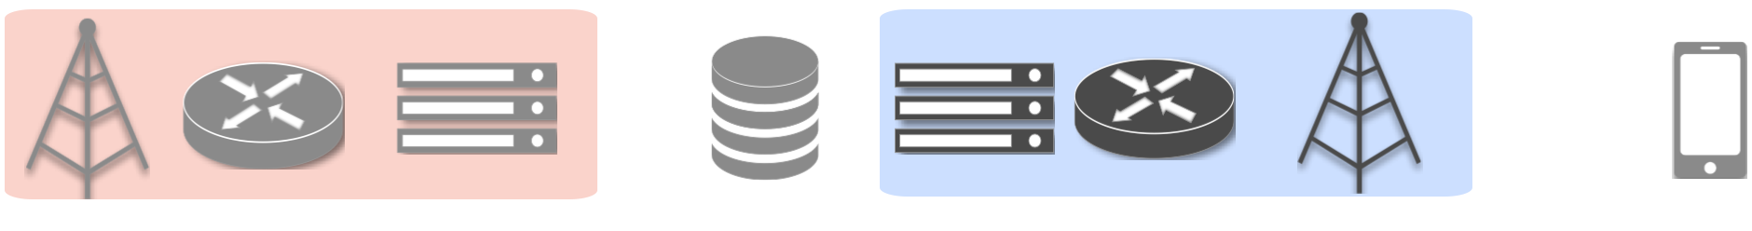
What Properties do We Want?
Correctness: Forward every packet under correct policies
  4G LTE: correctness via sequential consistency
Radio conn. setup
Location update request
Session state transfer
Routing update
User profile update
Location update accept
Notes:
To guarantee this, 4G LTE mandates the sequential execution of all the control procedures.
Indeed, this is very reasonable.

Slide 13
What Properties do We Want?
Correctness: Forward every packet under correct policies
Availability: start data service once route is connected
Internet
Data-plane
Control-plane
Tracking Area 1
Tracking Area 2
Notes:
The second property is availability.
That is, once the radio and data path are connected, the mobile data service should be immediately available to users.
This reflects our desire for a low-latency mobile network.

Slide 14
What Properties do We Want?
Correctness: Forward every packet under correct policies
Availability: start data service once route is connected
Partition tolerance: continuous operation once route is connected
Internet
Data-plane
Control-plane
Session state transfer
Tracking Area 1
Tracking Area 2
Continuous operation in presence of control-plane partition
  Data-plane partition: no data service can be offered anyway
Notes:
Last, we want the mobile data service to be fault tolerant.
Even when the control procedures experiences failures or partitions between network nodes, the mobile network infrastructure should continue to operate.
Please note that, in mobile network like 4G LTE, typically the out-of-band control is used.
The control plane partition (such as broken channel between mobility controllers) does not necessarily mean the data path is disconnected.

Slide 15
Can we achieve all properties?
CAP theorem on mobility support
Notes:
Now the question is: can we satisfy all of them simultaneously?
Unfortunately, the answer is no.
In distributed computing, people know it well for years.
In this area, we adopt it to the mobility support.
"We have broader knowledge and view than this community."

Slide 16
For any mobility support, it is impossible to always guarantee sequential consistency, availability, and control-plane partition tolerance simultaneously.
CAP Theorem for Mobility
Notes:
We have proven the following theorem for general mobility support, which is a variant of the classical CAP theorem.
For any mobility support, it is impossible to always guarantee sequential consistency, availability, and partition tolerance simultaneously.
This implies that, for any design that mandates sequential consistency, there always exist usage scenarios that availability cannot be guaranteed.
For the details of the proof, you can check our paper.
Here we will use a simple example in 4G LTE to give you some intuitions behind it.

Slide 17
Example: Control-Plane Partition Between 4G Tracking Areas
Internet
Data-plane
Control-plane
How should I operate now?
Session state transfer
Tracking Area 1
Tracking Area 2
Notes:
Suppose two tracking areas are partitioned at control plane, so that mobility controllers cannot migrate user’s data session states from one to another.
This can happen for many reasons, such as the mobility controller failures, control channel is broken, or the incompatibility between two mobility controllers under different technologies.
The problem is that, now the new mobility controller cannot get the latest data session states.
The old controller may update it when the device moves, but it cannot notify it to the new controller.
Now to satisfy partition tolerance, the mobility controller in tracking area 2 must continute to operate.
How should id do?
In general, there are two design options.

Slide 18
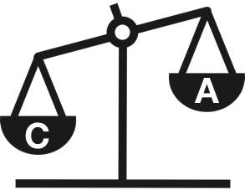
Option 1 (4G LTE): Consistency Over Availability
Suspend data service until the partition is recovered
Guaranteed correctness
✓
✓
Internet
Data-plane
Control-plane
Session state transfer
✓
✓
Tracking Area 1
Tracking Area 2
Notes:
The first option is adopted by current 4G LTE and even older 2G/3G.
It simply suspends the user’s mobile data service all control procedures are completed successfully.
Of course, this option guarantees the sequential consistency and thus correctness, since now every network node can only forward data when it has the up-to-date session state.
However, this causes very long data suspension. It violates the availability property.

Slide 19
Option 1 (4G LTE): How Much Delay in Reality?
Comparable to radio latency ☹: 193.8ms-6.4s (29.8-69.6%)
Notes:
In reality, we find that these suspensions are significant.
We have conducted a user study over 4 major U.S. LTE operators, and quantified the suspensions caused by the sequential consistency.
For the details of methodology and analysis, please read our paper.
Overall, there are two observations.
First, the suspension caused by sequential consistency is comparable to the last-mile wireless connectivity setup.
For each mobility support, the data suspension caused by control procedures fluctuates between 193.8 ms to 6.4 s. The average percentile ranges between 29.8% to 35.6% among operators, and the maximum percentile is 69.6%.
This partially justifies our motivation along this direction.
If more advanced wireless technologies are used in future 5G, this percentile will further increase. The signaling part will become the major bottleneck.

Slide 20
Option 1 (4G LTE): How Much Delay in Reality?
Comparable to radio latency ☹: 193.8ms-6.4s (29.8-69.6%)
Failure recovery incurs extra delay ☹: 500ms-30s
Notes:
Second, if control-plane failure happens, more suspensions would be incurred due to failure recovery, ranging from 500ms to up to 30s.
Clearly, this is not what mobile users want, since in this period it cannot use any data services.
Such long delay may even make some 5G mobile services impossible.
For example, some virtual reality applications requires tens of ms end-to-end latency.

Slide 21
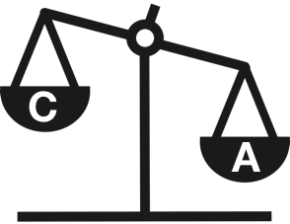
Option 2: Availability Over Consistency
Delivery user data without latest data session states
No guaranteed correctness: sequential consistency violated
?
Internet
?
Data-plane
Control-plane
Session state transfer
?
?
Tracking Area 1
Tracking Area 2
Notes:
There is another option.
In this option, the new tracking area begin to deliver user data without waiting for the device’s data session states.
Clearly, the availability is guaranteed, since the user can immediately get data service once the route is connected. Minimal suspension would be experienced.
However, now we cannot guarantee sequential consistency.
The nodes in new tracking area know that the device has moved, but the old nodes don’t.
It won’t be easy now to ensure that every packet is forwarded under the correct policy.
For example, the network may allocate higher QoS than what user deserves, or over charge the user mobile data based on incorrect data plan.

Slide 22
Summary: Impact of CAP Theorem
Consistency over Availability
  Guaranteed correctness ☺
  Long data service delay ☹
Availability over Consistency
  Correctness unguaranteed
  Immediate data service ☺
Notes:
So in summary, when we experience control-plane partitions, we can only pick up one of availability and sequential consistency.
The current mobility design like 2G-4G chooses to guarantee correctness by mandating the sequential consistency.
But as we have seen, this is slow, and may not be appropriate for new mobile services.
On the other hand, if we want to offer mobile users with highly-available mobile data service, mandating sequential consistency would not be a good choice.
However, this raises the question of how we can guarantee the correct mobile data service.
Here we should clarify that partition tolerance cannot be forfeited, since it is unavoidable for wide-area cellular infrastructure.
This theorem applies to any design, from 2G to future 5G.
Now back to our question: in 5G, what should we do? (pause)
Should we follow the wisdom in 2G—4G, or try a different tradeoff?
Our argument is that, to support new mobile services, 5G should not follow the old wisdom.
Instead, we seek to re-balance these properties to offer higher availability of mobile data services.

Slide 23
How to Balance Properties?
Between availability, consistency and fault tolerance
Notes:
Now let’s think about how to re-balance

Slide 24

Correctness, Not Sequential Consistency!
Sequential consistency is more than necessary for correctness
Availability
Correctness
Partition Tolerance
$$≠$$
More flexible consistency model to achieve all!
Sequential Consistency
Notes:
The key issue is that, 4G LTE implicitly binds correctness with sequential consistency.
However, are they equivalent?
Our answer is no.
We find that the sequential consistency is more than necessary for correct mobile data service.
Actually we can leverage a weaker consistency model to provide equivalently correct mobile data service.
In this way, we leave rooms to improve the availability and fault tolerance of mobile data service.
To give you some hints, we next analyze two cellular functions in mobility support.
For more functions, you can read our paper.
These analysis gives us confidence that such a model exists and is doable.

Slide 25
What Consistency is Required for Correctness?
Function 1: Data forwarding to correct location
  Only a subset of network nodes need latest user location
Internet
Data-plane
Control-plane
Tracking Area 1
Tracking Area 2
Notes:
The first cellular functions is data forwarding.
In 4G LTE, before offering data service, all network nodes involved should have the latest user location.
But in fact, to correctly deliver packets to roaming users, only a subset of network nodes should have updated view on user locations.
For uplink data from device to Internet, only the serving base station (that the device currently connects to) and forwarding gateways need to learn the latest user location.
For downlink data from Internet to device, the old gateways that relay packets to the device should know the latest user location.
Except them, other nodes can tolerate the delayed information of user location.

Slide 26
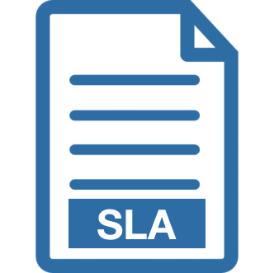
What Consistency is Required for Correctness?
Function 2: Volume-based data billing
  Decouple packet counting and billing policy
  Packet counting can be performed together with data forwarding
Internet
+
?
Data-plane
1
1
0
Control-plane
Tracking Area 1
Tracking Area 2
Notes:
The second function is data billing.
In the 4G network, the device is billed based on its data usage volume and per-flow charging rules.
To do so, each packet is thus counted and mapped to the proper flow for (possibly differentiated) charging.
In the current design, the data billing only starts after the forwarding gateway retrieves the user-specific charging rules.
However, this is too conservative for correct data charging.
Note that, we can decouple the data counting from the charging policies.
The data counting can be performed before the network nodes in new tracking area has installed the charging rules.
When later the user-specific charging rules are installed, data accounting can be eventually correct by mapping the data usage to the proper charging policy.

Slide 27
Other Cellular Functions in Paper
Radio access control
Cryptography over the air
QoS policy
Notes:
Our workshop paper discusses more cellular functions, such as the security and QoS.
Overall we find that all these functions can be correctly achieved with a more flexible consistency mode, rather than mandating the sequential consistency model.
If you are interested, you can read our paper.

Slide 28
Future Directions
What is the minimal consistency model for mobility support?
Can we have a continuous (thus tunable) balancing mechanism?
Will unreliable wireless connectivity affect the tradeoffs?
Notes:
This work is still a work in progress, and we believe that there are several important open issues that should be addressed in the future.
First, what I have shown to you are some hints that consistency model can be more flexible.
But for systematic design, we need a formal consistency model for mobility support.
The question is: what is the minimum consistency required in general to guarantee correct mobile data service?
This calls for more studies.
Second, what have I shown to you is a Boolean tradeoff: either availability or consistency.
In reality, if new cellular functions arrive, or the demand of suspension changes, maybe we want a more continuous or tunable tradeoff.
Can we do that?
Last, the overall design so far only considers the partition on the control plane.
In reality, many partitions can also happen due to the unreliable wireless link.
Possibly the CAP theorem will still hold, but will any differences?
How will it affect the tradeoff between different properties?
This requires more research efforts, particularly for experts in the wireless communication areas.

Slide 29
Conclusion
No free lunch for perfect mobility support
Sequential consistency is more than necessary for correctness
More flexible balance between C, A and P can benefits 5G
Notes:
To conclude, in this work we have shown that, mandating the sequential consistencyin mobility support design limits the potential for high availability and fault tolerance.
Because of the CAP theorem, there is no free lunch for HA an FT.
We believe that it is time for us to rethink the necessity of mandating the sequential control, since we are reaching the breaking point of the upcoming 5G network.
We argue that for HA and FT, 5G needs a paradigm shift from sequential consistency.
We hope our work can stimulate more research along this direction.
We can use more flexible consistency model.
Thank you for listening to my talk. I am happy to take your questions.

