Slide 1
Instability in Distributed Mobility Management
Yuanjie Li¹, Haotian Deng², Jiayao Li¹, Chunyi Peng¹, Songwu Lu¹
¹ University of California, Los Angeles
² The Ohio State University
Notes:
(30s)
Thanks for the introduction.
In this talk, we will present a new structural property in cellular network’s mobility management.
We will demonstrate the practical impact on mobile users, derive theoretical conditions for its satisfaction/violation, and present methods for its detection and resolution.

Slide 2


Mobility Management is Ubiquitous and Critical
Ubiquitous network service to mobile users anytime, anywhere
Vital for data performance and seamless connectivity
Cellular Networks
Notes:
The 3G/4G cellular network has become an essential part in our daily life.
It is the only large-scale infrastructure that provides “anywhere, anytime” mobile network service to users.
The key enabler is its mobility management, which determines the serving cell to the mobile device, and migrates the device to another as the device moves.
A good mobility management should provide seamless connectivity and high-speed data performance to users.

Slide 3
One Fundamental Property for Mobility: Stability
Definition: given invariant condition (location, radio qualities, traffic, etc.), the mobile device eventually associate with a single cell
Impact of violation: persistent loop
  User-experienced performance downgrade
  Excessive signaling overhead to network operators
Instability ≠ Transient loops
  E.g., caused by radio dynamics and user movement
Cell 1
Cell 3
Cell 2
Notes:
Emphasize the the stability differs from the radio link oscillations

Slide 4
This Work: Instability in 3G/4G Mobile Network
Our focus: instability caused by mobility management plane
Q1: Does unstable mobility management exist in reality?
Q2: When shall instability happen?
Q3: How to detect and prevent instabilities?
Cell 1
Cell 3
Cell 2

Slide 5
Q1: Does instability exist?
Unfortunately yes!

Slide 6
How does 3G/4G Mobility Management work?
Mobility management via handoff
Configurable mobility management
  Tunable parameters and decision logic
Distributed mobility management
  Each cell maintains local parameters and decision logic
Cell | Pref
Cell 1 | 4
Cell 2 | 6
Cell 3 | 3
Cell | Pref
Cell 1 | 5
Cell 2 | 3
Cell 3 | 3
HO
decision
1
2
Meas
Cell 1
Cell 3
3
Cell | Pref
Cell 1 | N/A
Cell 2 | 3
Cell 3 | 3
Movement
Cell 2
Notes:
TODO: visualize these points. Minimize wording

Slide 7
An Example of Unstable Handoff
Persistent loop: no convergence to single cell
  Under invariant setting: no radio oscillation, no mobility, stable traffic conditions, etc.
  Looped handoff every few minutes (90% loops <200s)
Cell 1 (4G)
Cell 3 (3G)
Cell 2
(Femtocell)
Notes:
TODO: visualize these points. Minimize wording

Slide 8
Unstable Handoff Hurts both Users and Operators!
For users: performance downgrade
  10x slow down
For operators: signaling overhead
  2-8x over-the-air messages
76s
180s
2.2x
3.5x
8.5x
3s
12s
Each handoff comes at a cost.
Persistent loops accumulate the costs!
Web latency
Video suspension
Notes:
TODO: visualize these points. Minimize wording

Slide 9
Root Cause: Preference Configuration Inconsistency
Diverse demands, with different preferences
  4G→Femtocell: Femtocell is more preferred for traffic offloading
  Femtocell->3G: equal preference, but 3G’s radio quality is better
  3G->Femtocell: 4G is more preferred for higher-speed network service
Cell | Pref
Cell 1 | 4
Cell 2 | 6
Cell 3 | 3
Cell | Pref
Cell 1 | 5
Cell 2 | 3
Cell 3 | 3
Pref_{3,3}< Pref_{3,1}
Cell 1 (4G)
Cell 3 (3G)
Well-justified individual cell’s handoff policy
≠
Well-justified interplay between cells’ policies
Pref_{1,1}< Pref_{1,2}
Cell | Pref
Cell 1 | N/A
Cell 2 | 3
Cell 3 | 3
Pref_{2,2}= Pref_{2,3}
Cell 2
(Femtocell)
Notes:
TODO: visualize these points. Minimize wording

Slide 10
Q2: When shall instability happen?
Formulation, analysis and experimental validations

Slide 11
Formulation of Handoff Stability
Cell 3 (3G)
Each handoff decision: s→[t = F_{s}(C,P)]
  s, t: serving/target cell
  C: set of candidate cells (with runtime meas)
  P: configurable parameters
  F_{s}: decision logic (function) for serving cell s
Handoff sequences: s→c₁→… → c_{i} → [c_{i+1} = F_{ci} (c_{i})] →… →t
Stability: for any invariant measurements, any handoff sequence always converge to a single cell t
Cell 1 (4G)
Cell 2
(Femtocell)
Notes:
TODO: visualize these points. Minimize wording

Slide 12
Causes of Instabilities: A Classification
Uncoordinated Parameter Configurations
Loop-prone handoff decision logics
Pref_{1,1}<Pref_{1,2}
γ₂>-108dBm
Pref_{1,1}>Pref_{1,2}
γ₁<-105dBm, γ₂>-110dBm
(Active)
γ₁<-102dBm, γ₂>-111dBm
Pref_{2,1}=Pref_{2,2}
γ₁> γ₂ +3dBm
Pref_{2,1}>Pref_{2,2}
γ₁>-108dBm
(Idle) Pref_{2,1}=Pref_{2,2}
γ₁> γ₂ +3dBm
Cell 1
Cell 2
BS 1
Cell 2
BS 1
Cell 2
Inconsistent preferences
Inconsistent thresholds
Active-idle misconfiguration
(Active)
Load balancing
γ₂>-106dBm
Cell 1
γ₁>-106dBm
Cell 2
Cell 1
(Idle) Pref_{2,1}=Pref_{2,2}
γ₁> γ₂ +3dBm
Cell 2
Active-state logic conflict
Active-idle logic conflict
Notes:
Uncoordinated parameter:
Loop-prone decision logic: for whichever parameter used, the loop will always happen
- Briefly explain how conflicting decision logic can occur.
WARNING: at this moment idle/active handoff is not introduced yet.
Figures are too complex. Simplify them.
Be consistent with previous figures: shape, color, etc.

Slide 13
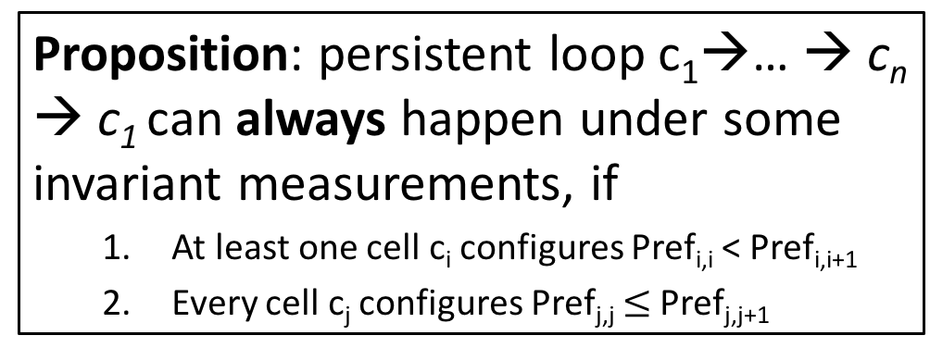
Inconsistent Preferences: Instability Condition
Proposition: persistent loop c₁→… → c_{n} → c₁ can always happen under some invariant measurements, if
  At least one cell c_{i} configures Pref_{i,i} < Pref_{i,i+1}
  Every cell c_{j} configures Pref_{j,j} $≤$ Pref_{j,j+1}
Cell | Pref
Cell 1 | 4
Cell 2 | 6
Cell 3 | 3
Cell | Pref
Cell 1 | 5
Cell 2 | 3
Cell 3 | 3
Pref_{3,3}< Pref_{3,1}
These inconsistencies should always be avoided
Cell 1 (4G)
Cell 3 (3G)
Pref_{1,1}< Pref_{1,2}
Cell | Pref
Cell 1 | N/A
Cell 2 | 3
Cell 3 | 3
Pref_{2,2}= Pref_{2,3}
Cell 2
(Femtocell)
Notes:
TODO: visualize these points. Minimize wording

Slide 14
Inconsistent Preferences: Empirical Validations
17 instances found in one U.S. operator
Diverse causes in reality
  4G-Femtocell-3G: uncoordinated handoff goals
  4G-Femtocell-2G-3G: device-side misconfiguration
  4G-4G: imprudent 4G infrastructure upgrade
c1 (4G, band 17)
c6 (3G, band 1900)
c2 (4G, band 2)
c5 (3G, band 850)
c7 (2G)
c3 (4G, band 4)
c4 (Femtocell)
Notes:
TODO: visualize these points. Minimize wording

Slide 15
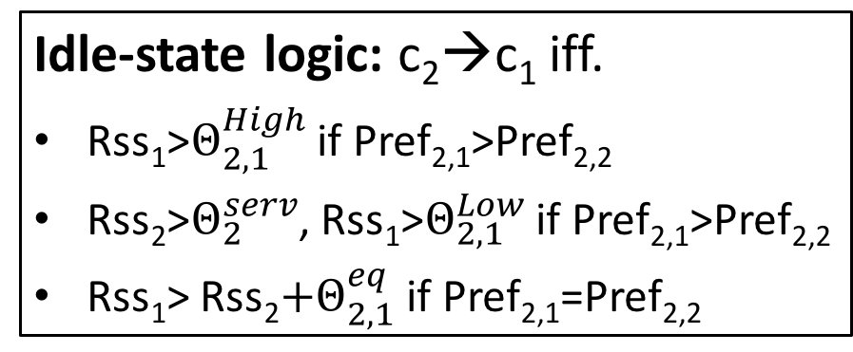
Active-Idle Logic Conflict: Instability Condition
Idle-state logic: c₂→c₁ iff.
Rss₁>$Θ_{2,1}^{High}$ if Pref_{2,1}>Pref_{2,2}
Rss₂>$Θ_{2}^{serv}$, Rss₁>$Θ_{2,1}^{Low}$ if Pref_{2,1}>Pref_{2,2}
Rss₁> Rss₂$+Θ_{2,1}^{eq}$ if Pref_{2,1}=Pref_{2,2}
Proposition: Two-cell persistent loop c₁→ c₂→ c₁always exists, if c₁’s active-state logic does not evaluate radio quality.
Idle-state logic is standardized
  Mandates the evaluation of cells’ radio quality
For stability, active-state decision logics must be regulated
Cell 1
Cell 2
Notes:
TODO: Re-plot the figures

Slide 16
Active-Idle Logic Conflict: Empirical Validations
Found in two U.S. network operators
A design loophole in 3G Radio Resource Control (RRC) protocol
  Active-state handoff: no evaluation of radio quality
  Conflicts with idle-state handoff decision logic
Cell 1 (3G)
Cell 2 (3G)
RRC conn. release:
Redirect to cell 2
Rss₁>Rss₂
Reselect to cell 1
Notes:
TODO: visualize these points. Minimize wording

Slide 17
Q3: How to Detect and Prevent Instabilities?
Persistent loop detection and fix guidelines

Slide 18

Persistent Loop Detection
Goal: uncover uncoordinated parameters and loop-prone logics
Approach: given parameters/logics, check (in)stability conditions
In-device implementation: help mobile device get rid of loops
Cellular Signaling Msg
(MobileInsight)
Decision Logic Inference
Counter
examples
Configuration Collector
Instability Condition Checker
Empirical
Validation
http://metro.cs.ucla.edu/mobile_insight/
Notes:
TODO: Mention MobileInsight

Slide 19
Persistent Loop Detection: Evaluation
Two major U.S. network operators
63 indoor locations, 50 outdoor locations
21 instances of instabilities detected, all observed in reality
Notes:
TODO: visualize these points. Minimize wording

Slide 20
Guideline for Instability Fix
Multiple fix schemes exist
Cell | Pref
Cell 1 | 4
Cell 2 | 6
Cell 3 | 3
Cell | Pref
Cell 1 | 5
Cell 2 | 3
Cell 3 | 3
Pref_{3,3}< Pref_{3,1}
Cell 1 (4G)
Cell 3 (3G)
Pref_{1,1}< Pref_{1,2}
Cell | Pref
Cell 1 | N/A
Cell 2 | 3
Cell 3 | 3
Pref_{2,2}= Pref_{2,3}
Cell 2
(Femtocell)
Notes:
TODO: convert the wording to animations

Slide 21
Guideline for Instability Fix
Multiple fix schemes exist
  Fix 1: on Cell 1, set Pref_{1,1}> Pref_{1,2}
Cell | Pref
Cell 1 | 7
Cell 2 | 6
Cell 3 | 3
Cell | Pref
Cell 1 | 5
Cell 2 | 3
Cell 3 | 3
Pref_{3,3}< Pref_{3,1}
Cell 1 (4G)
Cell 3 (3G)
Pref_{1,1}> Pref_{1,2}
Cell | Pref
Cell 1 | N/A
Cell 2 | 3
Cell 3 | 3
Pref_{2,2}= Pref_{2,3}
Cell 2
(Femtocell)
Notes:
TODO: convert the wording to animations

Slide 22
Guideline for Instability Fix
Multiple fix schemes exist
  Fix 1: on Cell 1, set Pref_{1,1}> Pref_{1,2}
  Fix 2: on Cell 2, set Pref_{2,2}> Pref_{2,3}
Cell | Pref
Cell 1 | 4
Cell 2 | 6
Cell 3 | 3
Cell | Pref
Cell 1 | 5
Cell 2 | 3
Cell 3 | 3
Pref_{3,3}< Pref_{3,1}
Cell 1 (4G)
Cell 3 (3G)
Pref_{1,1}< Pref_{1,2}
Cell | Pref
Cell 1 | N/A
Cell 2 | 4
Cell 3 | 3
Pref_{2,2}> Pref_{2,3}
Cell 2
(Femtocell)
Notes:
TODO: convert the wording to animations

Slide 23
Guideline for Instability Fix
Multiple fix schemes exist
  Fix 1: on Cell 1, set Pref_{1,1}> Pref_{1,2}
  Fix 2: on Cell 2, set Pref_{2,2}> Pref_{2,3}
But some fixes cause new loops
Cell | Pref
Cell 1 | 4
Cell 2 | 6
Cell 3 | 3
Cell | Pref
Cell 1 | 5
Cell 2 | 3
Cell 3 | 3
Pref_{3,3}< Pref_{3,1}
Cell 1 (4G)
Cell 3 (3G)
Pref_{1,1}< Pref_{1,2}
Cell | Pref
Cell 1 | N/A
Cell 2 | 3
Cell 3 | 3
Pref_{2,2}= Pref_{2,3}
Cell 2
(Femtocell)
Notes:
TODO: convert the wording to animations

Slide 24
Guideline for Instability Fix
Multiple fix schemes exist
  Fix 1: on Cell 1, set Pref_{1,1}> Pref_{1,2}
  Fix 2: on Cell 2, set Pref_{2,2}> Pref_{2,3}
But some fixes cause new loops
  Fix 3: on Cell 3, set Pref_{2,2}< Pref_{2,1}
Cell | Pref
Cell 1 | 4
Cell 2 | 6
Cell 3 | 3
Cell | Pref
Cell 1 | 5
Cell 2 | 3
Cell 3 | 3
Pref_{3,3}< Pref_{3,1}
Cell 1 (4G)
Cell 3 (3G)
Pref_{1,1}< Pref_{1,2}
Cell | Pref
Cell 1 | 4
Cell 2 | 3
Cell 3 | 3
Pref_{2,2}= Pref_{2,3}
Cell 2
(Femtocell)
Notes:
TODO: convert the wording to animations

Slide 25
Guideline for Instability Fix
Multiple fix schemes exist
  Fix 1: on Cell 1, set Pref_{1,1}> Pref_{1,2}
  Fix 2: on Cell 2, set Pref_{2,2}> Pref_{2,3}
But some fixes cause new loops
  Fix 3: on Cell 3, set Pref_{2,2}< Pref_{2,1}
  New loop: c₁→c₃→c₁
Cell | Pref
Cell 1 | 4
Cell 2 | 6
Cell 3 | 3
Cell | Pref
Cell 1 | 5
Cell 2 | 3
Cell 3 | 3
Pref_{3,3}< Pref_{3,1}
Guideline (monotonic fix): for any meas that cannot trigger c_{i}→c_{j} before applying the fix scheme, it should not trigger c_{i}→c_{j} after the fix
Cell 3 (3G)
Cell 1 (4G)
Pref_{1,1}< Pref_{1,2}
Cell | Pref
Cell 1 | 4
Cell 2 | 3
Cell 3 | 3
Pref_{2,2}= Pref_{2,3}
Cell 2
(Femtocell)
Notes:
TODO: convert the wording to animations

Slide 26
Conclusion
Instability exists in mobility management plane
  Distributed management in nature
  Negative impact: performance degradation, signaling overhead
Instability can be prevented with coordination of mobility management
  Regulation of parameters and decision logics are necessary
More aspects of mobility management remain open research areas
  More structural properties: reachability, security, consistency, etc.

Slide 27
Thank you!

Slide 28
Backup

Slide 29
Details of the Instability Conditions

