Slide 1



MobileInsight
Extracting and Analyzing
Cellular Network Information on Smartphones
Yuanjie Li¹, Chunyi Peng², Zengwen Yuan¹, Jiayao Li¹, Haotian Deng², Tao Wang³
¹University of California, Los Angeles
²The Ohio State University
³Peking University
Notes:
Thank you for the introduction.
In this talk, we will introduce MobileInsight,
a new methodology that lets our phones see through the black-box mobile networks.

Slide 2



Ubiquitous Cellular Network Services
…
2
Notes:
The 4G and 3G cellular networks are very critical infrastructure for mobile users.
Today, they are the only large-scale wireless infrastructure that offers wide-area mobile data service anytime, anywhere.
Their operations affect every mobile user and online apps.

Slide 3
But, We Suffer and Wonder…
Why Youtube video freezes?
…
Why my phone drains battery so quickly?
4 signal bars, but why no data service?
Why my 4G phone switches to slow 2G?
3
Notes:
However, although we use 3G/4G network everyday,
we keep suffering from network failures, bad performance, fast battery drain and security threats, without knowing why and how.
We don’t know why mobile video freezes.
We don’t know why we cannot use data even with 4 signal bars.
We don’t know whether this is caused by radio jamming attacks or for other reasons.
We don’t know why I move to slow 2G even under good 4G radio coverage.
We don’t know why our phone drains faster battery than we expected.
This list just goes longer and longer.

Slide 4
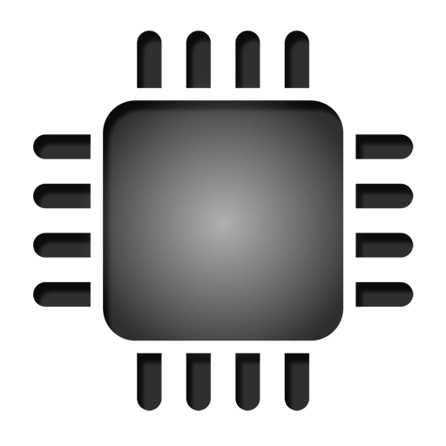
Cellular Operations Remain “Closed”
Session Management (SM)
…
Mobility Management (MM)
Radio Resource Control (RRC)
Software
Link Layer (MAC/RLC/PDCP)
Hardware
Physical Layer (PHY)
4
Notes:
The reason is that, All problems can be related to the underlying cellular utility functions, such as radio resource allocation, mobility management, data service quality, cellular traffic shceduling, power control and security.
But these cellular operations remain closed to us.
They are realized by multiple cellular-specific signaling protocols, ranging from the physical layer, link layer, RRC, MM and SM.

Slide 5
Cellular Operations Remain “Closed”
?
Session Management (SM)
Mobility Management (MM)
Radio Resource Control (RRC)
Software
Link Layer (MAC/RLC/PDCP)
?
Hardware
Physical Layer (PHY)
?
?
?
5
Notes:
However, different from the Internet’s TCP/IP stack, on the phone side, all these protocols are implemented inside the hardware cellular chipsets and not exposed to software space
Mobile apps have very limited access to all these runtime operations through standard mechanisms like Android APIs.

Slide 6
Can We Have Open Access to Runtime Cellular Operations?
Notes:
So we ask a very simple question: Can We Have Open Access to Runtime Cellular Operations?
We want both data and analytics of dynamic cellular protocol behaviors at software space inside our phones.
With this capability, we could not only have direct hints to resolve these problems, but also stimulate many new research opportunities in the cellular world.
In the end of the talk, I will show some of new research opportunities with this capability.
But now let’s focus on how to solve this problem.

Slide 7
It’s Not That Simple
Full coverage
Fine grained
Analysis
At scale
In-phone
Android APIs
✘
✘
✘
✔
✔
External Tools
(e.g., QXDM)
✔
✔
✘
✘
✘
Operator-side
cellular analytics
✔
✔
✔
✘
✘
Notes:
Actually, this is not a simple task.
To achieve it, we need a tool with five features.
We need to collect information from all cellular protocols, ranging from the physical layer, MAC layer, radio resource control, mobility management and data session management layers.
For each protocol, it can get fine-grained information such as state dynamics, configuration parameters and operation logics.
It can perform runtime analysis of each protocol.
To cover wide areas, both data collection and analytics can be easily performed at scale anywhere anytime.
All these features should be achieved and readily deployable inside the our off-the-shelf phone, without extra hardware support.
Unfortunately, no existing approaches can satisfy all of them and achieve our goal.

Slide 8
Our Solution: MobileInsight
Full coverage
Fine grained
Analysis
At scale
In-phone
✔
✔
✔
✔
✔
Android APIs
✘
✘
✘
✔
✔
External Tools
(e.g., QXDM)
✔
✔
✘
✘
✘
Operator-side
cellular analytics
✔
✔
✔
✘
✘
Notes:
In this work, we present our solution, MobileInsight.
MobileInsight is a mobile app for our off-the-shelf phones.
It satisfies all necessary features, and provides open access to fine-grained, runtime cellular information on 3G/4G network.
It has been publicly released as a community tool, and now downloaded by 36 research institutes.

Slide 9
Outline
Design
Evaluation
Showcase examples
Conclusion
Notes:
In the rest of the talk, we will show how MI works, evaluate MI in various aspects, show how MobileInsight enables new research, and conclude our work.

Slide 10
MobileInsight Overview
Monitor
Software
Hardware
SM
MM
RRC
01101
MAC/RLC/PDCP
PHY
Notes:
Let’s first look at how MobleInsight works at high level.
It runs as a user-space software service on off-the-shelf phones, and has three components: monitor, analyzers, APIs.
It first passively exposes over-the-air cellular signaling messages from hardware to software.
These messages were exchanged between our phone and network, and cover a wide range of cellular protocols, from lowest PHY to highest data session management.
They carry the fine-grained information of cellular protocols like states and parameters.

Slide 11
MobileInsight Overview
Monitor
Analyzers
API
…
Software
Hardware
Notes:
With these information, MobileInsight further performs the runtime cellular protocol analytics, such as tracking each protocol’s state machine dynamics, and inferring its operation logics from the operators.
With MobileInsight’s APIs, researchers can leverage these information to have a more accurate understanding of cellular operations, and developers can build new mobile apps.
We next introduce each component.

Slide 12
In-device Runtime Monitor
How to expose runtime cellular messages to user space?
Monitor
Analyzers
API
Notes:
The first component is in-device runtime monitor.
To enable it, we first need to expose the raw over-the-air cellular messages from the hardware to software.

Slide 13
Challenge: No Ordinary In-device Schemes
…
Android APIs
Software
Radio Interface Layer
Hardware
Coarse-grained
cellular info
Monitor
Analyzers
API
Notes:
This is not easy.
As we have seen before, the ordinary in-device schemes cannot support it.
For example, in Android, the cellular chipset only exposes a subset of basic, coarse-grained cellular information to software space through the Android APIs.
Then how can we expose fine-grained cellular info?

Slide 14
Solution: Side-Channel Across SW-HW Boundary
Parsers
…
Proxy
via USB
Raw cellular
messages
Android APIs
Software
/dev/diag
Radio Interface Layer
Hardware
Coarse-grained
cellular info
Monitor
Analyzers
API
Notes:
Our solution is to enable a new side-channel across software-hardware boundaries inside the phone.
We find that the chipset supports an external diagnostic mode, which exposes all raw cellular messages as binary streams to USB.
MOBILEINSIGHT leverages this feature, but emulates an external logger inside the phone.
To do so, it adapts the diagnostic port inside the phone, issues I/O control commands based on its open-source driver info, and redirects the raw cellular information from USB to the user space.
Once we have raw cellular messages, we can parse them and get a rich set of the information.
There are many detailed issues in parsing these cellular messages, such as how to handle the rich message formats, how to handle the parsing dependency between different messages, how to optimize the parsing speed for real-time demand.
For the details on how we solve these problems, please read our paper.

Slide 15
Cellular Protocol Analytics
How to unveil runtime cellular protocol behaviors?
Monitor
Analyzers
API
Notes:
With the cellular messages, the next task for MOBILEINSIGHT is to perform runtime analytics for cellular protocol behaviors.

Slide 16
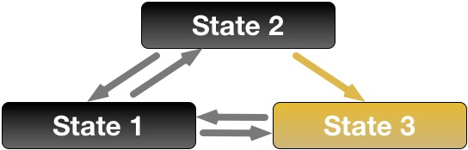
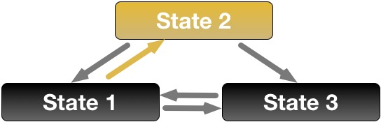
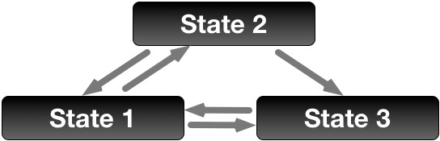
Two Dimensions for Each Protocol
State dynamics extraction
  Device side
Operation logic inference
  Network side
Monitor
Analyzers
API
Notes:
For each protocol, we uncover two dimensions of its behaviors:
tracking device-side protocol state dynamics,
and inferring network-side protocol operation logic.
Let’s look at each dimension.

Slide 17
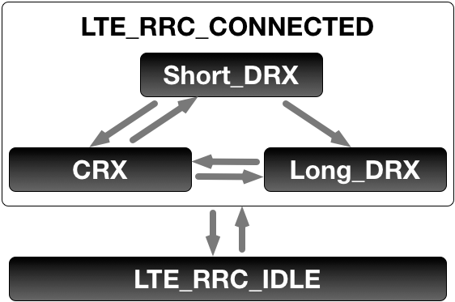
Protocol Analytics: Tracking State Dynamics
Current protocol state, transition events and causes
  RRC: Radio connectivity status and power-saving mode
  MM: Device registration status
  SM: Data session activity and QoS status
Monitor
Analyzers
API
Notes:
The first task is to track device-side protocol state dynamics.
This includes the runtime protocol states and transition events and why transition happens.
For example, for radio resource control the state dynamics tell us the radio connectivity dynamics between device and the base station.
For MM it is the registration status of the phone to the mobile network.
For SM it is the data session activity and QoS status.
We use the 4G RRC protocol as one example.

Slide 18
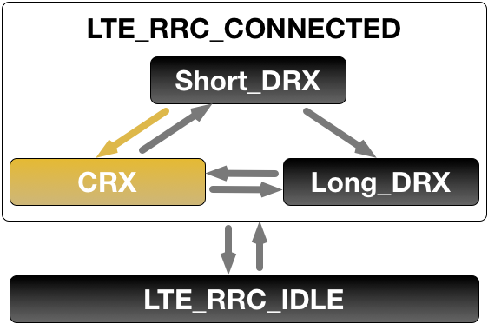
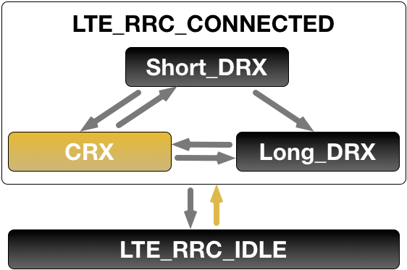
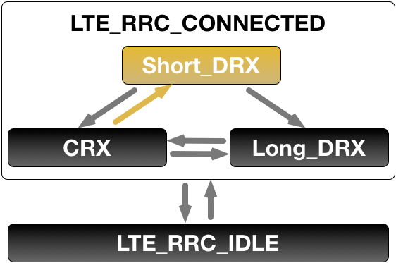

Protocol Analytics: Tracking State Dynamics
Observation: regulated by the cellular standards
Reference state machine
  + runtime message
RRC conn. setup request
RRC conn. setup accept
T₁
T₂
T₁
Data
T₁
Data
RRC conn. reconfiguration
Parameters: T₁=100ms,
T_{shortDRX}=20ms
T₂=2 T_{shortDRX}
Data
Conn. release
Conn. setup
Conn. setup
Downlink data
Monitor
Analyzers
API
……
Notes:
To track its state dynamics, our key observation is that, the device-side state dynamics are regulated by the cellular standards.
This allows us to perform a two-phase approach.
We first derives a state machine from the 3GPP standards.
This model abstracts the device-side states and transition conditions as a function of cellular messages.
We then feed runtime cellular messages from our in-device monitor to this model.
This provides the ground truth of the device-side protocol state dynamics, since it is strictly based on the standardized protocol state machine and runtime cellular messages.

Slide 19
Protocol Analytics: Inferring Operation Logic
Algorithm to determine protocol configurations and actions
  Example: handoff decision logic
BS 3 (3G)
BS 2 (4G)
BS 1 (4G)
Monitor
Analyzers
API
Notes:
Besides device-side protocol state dynamics, MobileInsight can also infer certain protocol operation logic from the network.
The operation logic is the network carrier’s internal algorithm or policy that determine the protocol configurations and messages to send/receive.
For example, the base station’s handoff decision logic tells us when our phones are asked to move to 2G, and when to move to 4G.

Slide 20
Inferring Operation Logic is Not Simple
Challenge #1: Non-standardized, carrier-specific operations
Challenge #2: Internal logic, not visible by end device
BS 3 (3G)
?
BS 2 (4G)
BS 1 (4G)
Monitor
Analyzers
API
Notes:
However, different from the device-side protocol state dynamics, we face two challenges here.
First, the operation logic varies between network operators. It is not standardized. So we do not have reference logic here.
Second, these internal operation logics are not visible by end mobile devices.
How can we infer it?

Slide 21
Observation: Operation Logic is Not Arbitrary
Many network-side operations are stateful
BS 3 (3G)
BS 2 (4G)
BS 1 (4G)
Monitor
Analyzers
API
Notes:
Our key observation is that, the operation logic is not arbitrary in reality.
It typically has an inherent structure for two reasons.
First, many network-side protocol operations are stateful.
In this example, to make a proper decision, the network should know device-perceived radio quality among neighboring cells.
Each state represents a control command issued by network, which asks the phone to monitor neighboring cells and perform a handoff.
The state transition is triggered after the phone reports measurements of neighboring cells to the network.
Although the decision logic is customizable, they are regulated by standardized mechanisms and thus can be converted into an equivalent state machine.
So it is possible to learn this internal structure.

Slide 22
Observation: Operation Logic is Not Arbitrary
Many network-side operations are stateful and interactive
Solution: Online state machine inference
BS 3 (3G)
BS 1 (4G)
Meas Control: Monitor 4G
Meas Report: RSS₂> RSS₁+3
Handoff command: to BS2
BS 2 (4G)
BS 1 (4G)
Monitor
Analyzers
API
Notes:
Second, the network-side operations is usually interactive. It relies on the phone-side feedbacks to make decisions, any may involve multiple rounds since further meas may be required.
Because of this, although the phone cannot see the internal operation logic, it can see the runtime commands from network, and its feedback to the network, all of which implies how the decision logic works.
Based on these two observations, MobileInsight performs online state machine inference to learn its internal logic.
Our solution is based on the query-driven state machine merging algorithm from the AI area.
We model network operations as a finite-state machine, and infer its form by pairing the control commands initiated by network and device-side feedbacks.
We use a simplified example to show how it works. It has two steps.

Slide 23
State Machine Inference: Partial Recovery
Runtime sample sequence 1
BS 1 (4G)
Meas Control: Monitor 4G
BS 3 (3G)
Meas Report: RSS₂> RSS₁+3
Handoff command: to BS2
BS 2 (4G)
BS 1 (4G)
Monitor
Analyzers
API
Notes:
First, for each sample of runtime message sequence, MobileInsight partially recovers the state machine. It creates a new state when observing a control commands, and records the feedback sequences between control commands as the transition conditions.

Slide 24
State Machine Inference: Partial Recovery
Runtime sample sequence 2
BS 1 (4G)
Meas Control: Monitor 4G
BS 3 (3G)
Meas Report: RSS₁<-110
Meas Control: Monitor 3G&4G
Meas Report: RSS₂>-90
Handoff command: to BS3
BS 2 (4G)
BS 1 (4G)
Monitor
Analyzers
API
Notes:
In this way, we can recover multiple partial state machines from different sequences.

Slide 25
State Machine Inference: Aggregation a
BS 1 (4G)
Meas Control: Monitor 4G
BS 3 (3G)
Meas Report: RSS₁<-110
Meas Control: Monitor 3G&4G
Meas Report: RSS₂>-90
Handoff command: to BS3
BS 2 (4G)
BS 1 (4G)
Monitor
Analyzers
API
Notes:
Then we move to the next step. We merge the inferred partial state machines with existing ones.
With sufficient runtime sequences, we can recover the complete state machine.
The complete inference algorithm would be more complex.
For more details, please read our paper.

Slide 26
MobileInsight APIs
src = OnlineMonitor()
lte_rrc_analyzer = LteRrcAnalyzer() wcdma_rrc_analyzer = WcdmaRrcAnalyzer() lte_rrc_analyzer.set_source(src)
wcdma_rrc_analyzer.set_source(src)
src.run()
Monitor
Analyzers
API
More tutorials: http://metro.cs.ucla.edu/mobile_insight/tutorials.html
Notes:
MobileInsight provides very simple and extensible APIs for mobile apps in Python.
Here we show a simple example on how to track the 3G/4G radio resource control protocol state dynamics.
All we need to do is to declare an in-device runtime monitor, declare our built-in protocol analyzers for 3G and 4G RRC protocol, bind them to the monitor, then run it.
In our latest version, we also enable a new set of APIs with simpler semantics.
For details, you can check our online tutorials.

Slide 27
Evaluation
Coverage, performance, accuracy and system overhead
Notes:
We next summarize our evaluation of MobileInsight in four aspects: its wide coverage of phone models and messages, its responsiveness in processing runtime cellular messages, its effectiveness of performing protocol analytics, and its system overhead.
For complete results, please check our paper.

Slide 28
Wide Coverage of Phone Models
Mobile OS | Cellular Chipset | Feasibility
Android | Qualcomm | ✔
 | MediaTek | ✔
 | Intel XMM | ✔
iOS | All | ✔
Mobile OS | Cellular Chipset | Feasibility | Current Version (2.1.1)
Android | Qualcomm | ✔ | ✔
 | MediaTek | ✔ | ✘
 | Intel XMM | ✔ | ✘
iOS | All | ✔ | ✘
Notes:
MobileInsight has covered a wide range of phone models.
We have verified the feasibility of applying MobileInsight to major cellular chipsets, such as Qualcomm, MediaTek and Intel XMM and mobile OS such as Android and iOS.
Our paper offers more details about the verification.
In our latest public version, we have implemented rooted Android phones with Qualcomm chipsets.
We will release the iOS version in next few months.

Slide 29
Wide Coverage of Cellular Protocols/Messages
3G/4G signaling messages and 4G-L1/L2 messages
Dataset size | 245.24GB
Total messages | 72,389,300
Protocol Layers | 4G-PHY (71.8%), 4G-MAC (9.0%), 4G-PDCP (8.3%), 3G/4G-RRC (10.0%), 3G/4G-MM/SM (0.6%), 3GPP2-EvDo/CDMA (0.3%)
Notes:
MobileInsight has supported a wide all 3G/4G signaling messages and some 4G PHY-layer and link-layer messages.
To validate it, we have performed a 13-month user study over 30 phones and 8 network operators, and collected 245GB signaling data with 72 million cellular messages.
We have validated that all these messages have been successfully collected.
For the characteristics of these message traffic patterns, you can read our papers.
We have release this dataset to public, now you are free to download.

Slide 30
Real-time Processing of Cellular Messages
Finish 99% messages’ parsing and analyzing within 0.8ms
  33ms in the worst case
Notes:
MI can largely meets the real-time requirement.
We have tested how fast MobileInsight parse and analyze each cellular messages.
We run this test on three phone models: the low-end LG Tribute, the medium Samsung S5 and high-end Nexus 6P, and test it under light and heavy cellular message arrival rates.
Our experiments show that, for 99% cellular messages, they can be parsed and analyzed in less than 0.8ms.
The maximum processing time observed is 33ms.
This validates MobileInsight largely meets the real-time requirement.

Slide 31
Accurate Cellular Protocol Analytics
Tracking protocol state dynamics: identical as QXDM
Inferring handoff operation logic: 87.5%~95.3% accuracy
 | AT&T | T-Mobile | Sprint | Verizon
#Samples | 11,050 | 10,178 | 10,042 | 2,741
Accuracy | 90.7% | 91.8% | 95.3% | 87.5%
Notes:
MobileInsight performs accurate cellular protocol analytics in both protocol dynamics and operation logic.
For protocol state dynamics, MobileInsight can correctly track runtime protocol states and key configurations.
We confirm that it extracts same runtime cellular information as QXDM, the de facto cellular network debugger on desktop.
This is not surprising, MobileInsight leverages the same data source of runtime cellular messages as QXDM.
For handoff operation logics, we don’t have the ground truth to directly assess the correctness of the inferred algorithm.
So we use an indirect approach.
We first infer the operation logic, then use it to predict the handoffs given the runtime traces.
We run a 10-fold cross validation.
This table shows the results from different operators.
It shows that, for all operators, MobileInsight’s inferred algorithm yields high prediction accuracy, ranging from 87.5% to 95.3%.

Slide 32
Acceptable System Overhead
CPU utilization: 1%-7%
Memory: 30MB at maximum
Energy: 11-58mW extra power consumption
Notes:
MobileInsight consumes reasonable system resources.
It consumes 1-7% CPU, 30MB memory and 11-58mW extra power.

Slide 33
Showcase Examples
How can MobileInsight stimulate new research?
Notes:
We last show how MobileInsight can stimulate new research and mobile applications.

Slide 34
Research Empowered by MobileInsight
This work: network failure resolution, security loophole detection, performance boost
  By tracking protocol state dynamics and inferring operation logic
iCellular [NSDI’16]: Device-customized multi-carrier roaming
MMDiag [SIGMETRICS’16]: mobility misconfiguration detection
Notes:
With MobileInsight, our paper has shown three showcase applications:
A network failure diagnosis tool that helps our phones fix network failures,
A security loophole detector that warns mobile apps of the potential threats over the air,
And a performance booster that helps phones get rid of slow 2G/3G networks, and even help improve mobile video quality.
All these can be achieved by tracking the protocol state dynamics and operation logics.
For details of showcase examples, you can check our papers.
We also have demos for some of these applications. If you are interested in, we can show you offline.
Besides, MobileInsight also helps us empower our phones with more intelligent roaming with multi-carrier access, and even figure out and resolve network operators’ protocol misconfigurations.
For details, you can read these papers.

Slide 35

New Research Opportunities Made Possible
Mobile big data analytics
Cellular protocol refinements
Security threats detections
Cross-layer app enhancements
Notes:
With MobileInsight’s data and analytics, many more new research opportunities are now made possible.
We can enable large-scale mobile big data analytics, by crowdsourcing runtime cellular operations from mobile users in every location and at any time.
Our latest version of MobileInsight has enabled the data sharing function on the phone, which helps us move toward this direction.
By understanding the problems of today’s cellular operations, we can propose new solutions for future 5G to reduce the deficiencies of the radio resource allocation and scheduling, wireless link interference and propose better designs, and improve the reliability and efficiency of the cellular signaling protocols.
We can also detect the security and privacy issues from the low-level cellular operations, such as radio jamming, user location leakage, DoS attacks, etc.
We could also enable a new set of mobile applications, such as cross-layer optimiazation for mobile Web and video, network failure diagnosis, to name a few.

Slide 36
Conclusion
In-device open access to cellular operations is beneficial
  To mobile users, researchers, developers and network operators
MobileInsight: a first effort toward an open cellular world
More community efforts are needed for extension
  A tool for the community and by the community
Notes:
In summary, we believe that in-device open access to cellular network operations is a useful paradigm.
Similar to the Internet, such open access would benefit everyone, from end users, researchers developers to even network carriers.
MobileInsight is our first effort toward this goal.
But definitely we need community efforts toward it.
In fact, MobileInsight is designed to be a tool for the community and by the community.
We would encourage everyone to use MobileInsight and contribute to its development, extension and research.
We have released MobileInsight to community as a free tool, and we have released our 245GB dataset as well.

Slide 37
Try MobileInsight and explore more! http://metro.cs.ucla.edu/mobile_insight
Yuanjie Li¹, Chunyi Peng², Zengwen Yuan¹, Jiayao Li¹, Haotian Deng², Tao Wang³
¹University of California, Los Angeles
²The Ohio State University
³Peking University
Notes:
This is not the end of MobileInsight.
Try MobileInsight and Explore More!

