Slide 1
Bridging the Data Charging Gap in the Cellular Edge
Yuanjie Li, Kyu-Han Kim, Christina Vlachou, Junqing Xie
October 10, 2019
Notes:
In this talk, I will show you a new way to protect our data bills in the mobile edge networking.
This is a joint work with Kyu-Han, Christina, and Junqing.

Slide 2
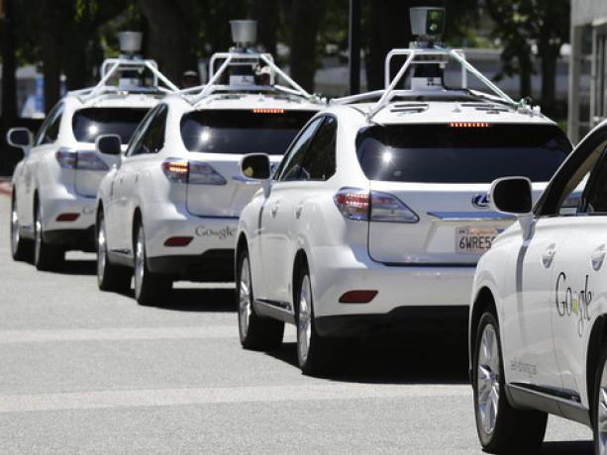






Intelligent wireless edge
Enable ultra low-latency services for the next-generation applications
Notes:
The intelligent wireless edge is redefining our digital lives.
It promises ultra low latency for the emergent applications, such as real-time video analytics, mobile VR, online mobile gaming, safe autonomous driving, high-speed rails, to name a few.
The wireless edge consists of the edge devices, edge server, and wireless network
The edge device can be cameras/vehicles/IoT gateways
The edge server is close to wireless access for low latency. It can offload the device’s computation, run analytics, and aggregate results from devices through wireless network
The edge applications span on edge device and server

Slide 3
Intelligent wireless edge via cellular networks
“Anywhere, anytime” low latency wireless access via 4G LTE and 5G
Cellular edge
4G gateways
5G gateways
Notes:
Many wireless edge scenarios need low-latency access no matter they are in the indoor or outdoor environment, and static or mobile settings.
A promising solution is the cellular edge, which has been under active standardization and early deployments since 2017.
To date, the 4G LTE and emerging 5G cellular networks are the largest wireless infrastructures that offer ubiquitous coverage and seamless mobility support.
The cellular network consist of radio network and core network gateways.
The radio network contains base stations covering geographical areas, and provides wireless access to the mobile devices.
The core network gateway connects the radio access network to the edge server.

Slide 4
The cellular edge’s network traffic is not free!
Cellular network operators charge the edge app vendors by data volume
Cellular edge
4G gateways
Camera: 10GB UL, 1GB DL
Charging function
VR: 1GB UL, 15GB DL
5G gateways
Notes:
The cellular network data is not free.
Similar to our smartphones’ data plans, the edge app vendors should pay for the cellular operators by how much low-latency network traffic it uses
Today, the charging is fully decided by the cellular network operator:
The cellular network’s internal gateways forward the edge traffic, count their traffic volume, applies for diverse billing policies, and generates the final bills for edge application vendors.

Slide 5
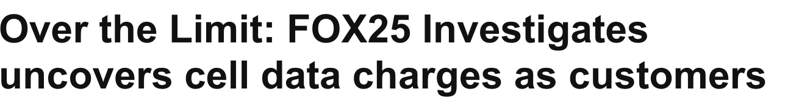
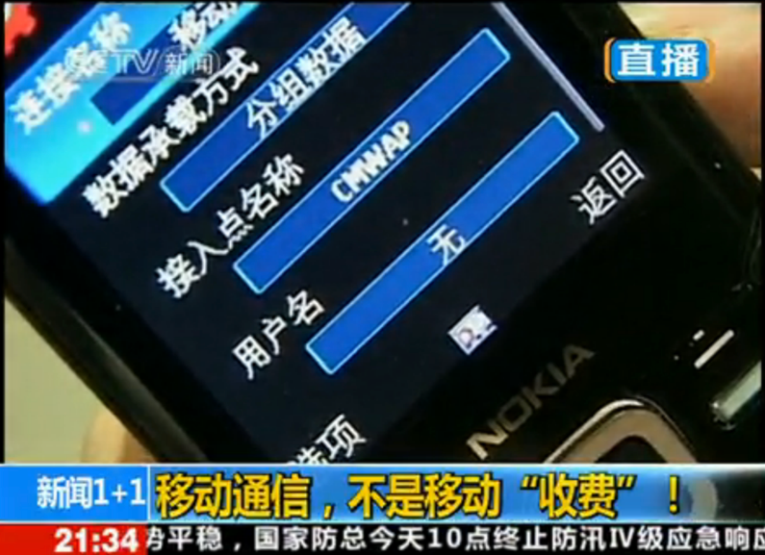
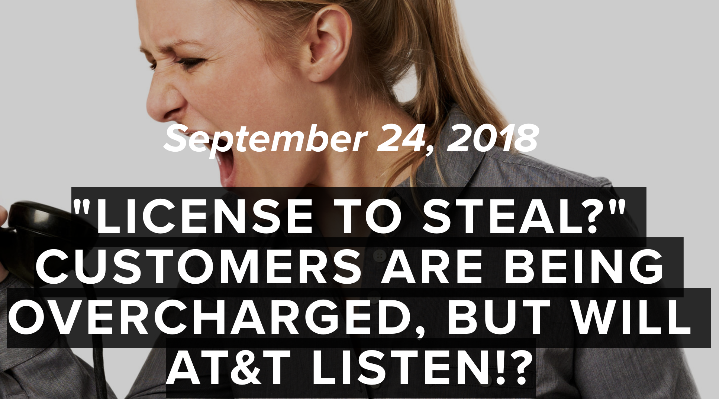
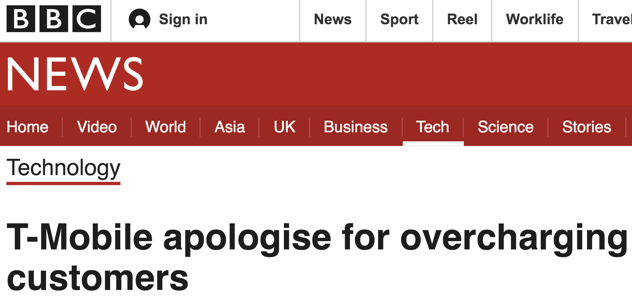
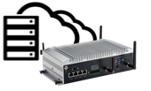
Is data charging in the cellular edge always trustworthy?
No! The data charging gap exists
The cellular operator and edge app vendor do not always agree on how much data should be charged
This work:
  What causes the data charging gap?
  Why is it hard to bridge the gap?
  How to bridge the gap in the cellular edge?
“I consumed 5GB data”
“You consumed 10GB data”
Sources: CCTV, BBC, FOX25, Radvocate
5
Notes:
The data charging is crucial for the cellular operator’s revenue and edge app vendors’ operation cost.
Given its importance, it should be always trustworthy and reliable.
But is it? (pause) Unfortunately, the answer is NO
The cellular operator and edge app vendor may not always agree with each other on how much data should be paid. We call this data charging gap.
This problem has existed for decades, and been widely experienced by mobile users and operators.
The cellular edge is no exception, and its charging gap will be even larger due to its low-latency demands.
In this talk, I will show you
The causes of data charging gap;
Why it is hard to bridge the gap in the edge; and
How we can solve this problem in the cellular edge.

Slide 6
What causes the data charging gap in cellular edge?
Data loss
  Enlarged by edge’s low-latency demand
    No loss recovery by UDP-based real-time protocol
    Data drop after exceeding delay deadline
  From all layers at network & edge
Application layer:
SLA deadline expiry
Transport layer:
Spurious retransmission; no loss recovery in UDP
IP layer:
Network congestion; TTL expiry
Edge applications | Charging gap
WebCam (1080p, RTSP) | 8 MB/hour
WebCam (1080p, UDP) | 59 MB/hour
Mobile VR (1080p, GVSP) | 81 MB/hour
Link layer:
Device mobility; loss recovery disabled
Physical layer:
Intermittent wireless connectivity
Notes:
Let’s look at the first question: What causes the charging gap?
Generally speaking, there are two big categories.
First, the network traffic can be lost during the delivery, but it may has been counted by the cellular operator’s gateways. The operator may thus charge data that the edge did not receive.
In the general mobile date charging for our smartphones, such gap is usually small, because most mobile applications use TCP for reliable data transfer and loss recovery.
But cellular edge is different: The loss-induced charging gap can be enlarged because
For low-latency, many edge apps use UDP-based real-time protocols, which do not always recover the lost data
For some applications, the data can be dropped if missing deadlines
We test various edge apps w/ Qualcomm LTE small cells & commercial OpenEPC LTE core
On average, for every hour, the charging gap will increase 8-80MB total edge traffic in WebCam and edge-based mobile VR
With intermittent wireless and congestion, the gap goes up to 252MB/hr for WebCam and 982MB/hr for mobile VR,
Prior large-scale measurements have shown that, lost data can arise from all network layers on edge and network, such as the PHY-layer intermittent wireless connectivity, link-layer device mobility, IP-layer congestion, transport-layer retransmission, application-layer SLA violation, and more.
For more details of these causes, please read our paper.

Slide 7
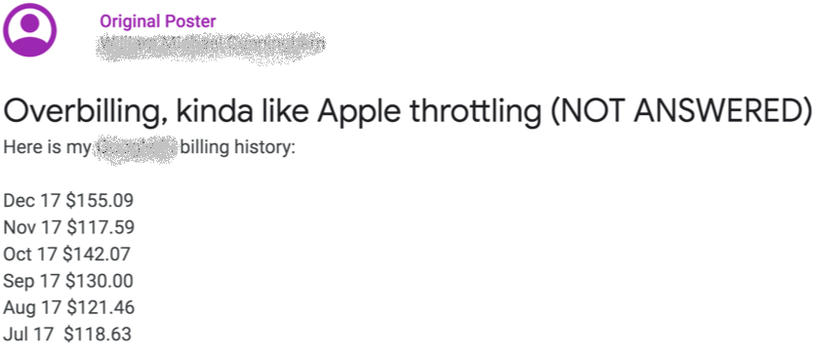
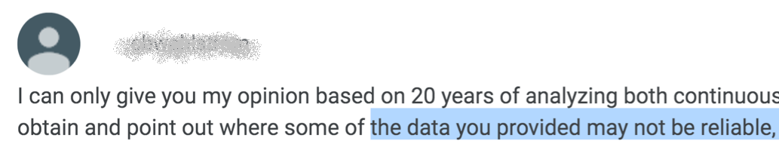
What causes the data charging gap in cellular edge?
Data loss
Selfish charging
Economic incentives for
  Cellular operator to over-claim the data volume for more billing
  Edge app vendor to under-claim the data volume for less payment
Unbounded, arbitrary selfish charging claims are possible in 4G/5G today
Sources: Google forum
Notes:
The second cause is the selfish charging.
For their own benefits, both operator and edge vendor have economic incentives to manipulate their charging claims.
To charge more money, a selfish cellular operator may over-claim the data volume the edge app vendor has used
To save its data bills, a selfish app vendor may under-claim the data volume it has used
Of course, we believe most cellular operators and edge app vendors are honest and self-regulated.
But although unlikely to be common, they are not without foundations. Here is a real example.
A user posts his data bills on the online forum, and claimed he was overcharged by the operators
After communication, the operator says the following XXX, which implies that the user seems to under-claim his bills.
This is not the only case. In some extreme scenarios, such debates even ended up with lawsuits.
Moreover, 4G/5G today, such selfish charging claims are unbounded:
The operator can claim arbitrarily high charging volumes;
The edge app vendor can arbitrarily low volumes.

Slide 8
Why is it hard to bridge the gap?
Data loss
Selfish charging
We pay for the low latency!
Why: Without synchronization (thus latency), one cannot always differentiate
  No data transfer (no charging)
  Data loss (may be charged)
Loss-latency tradeoff
Theorem:
Impossible for any designs or honest participants to simultaneously guarantee no loss-induced charging gap, and eventually available charging report (latency)
Notes:
It turns out that, it is not easy to eliminate the charging gaps from data loss and selfish charging.
That’s why this issue has been in place for decades.
There are three challenges.
First, even if we assume all participants are not selfish, we face a fundamental tradeoff between loss-induced gap & latency.
Intuitively, bridging the loss-induced gap is equivalent to a distributed counting problem:
Edge nodes and cellular network locally count the traffic volume
Bridging the gap is equivalent to achieving consistent counting.
If both are honest, an intuitive solution is to sync the network and edge’s charging records.
However, this is at the cost of latency: Before sync, edge’s traffic will be delayed.
In fact, we can prove the following theorem: For any design, if the data can be arbitrarily lost, it is impossible to always guarantee two properties simultaneously
the edge nodes and network have consistent view of charging volume, thus no gap
The charging record query will eventually return, thus low latency,
That is, for any design, we pay for the low-latency edge traffic.
If you are familiar with dist. computing, you will find that this is a variant of classical CAP theorem.
For the complete proof, please read the paper. But the intuition is simple: If the data can be arbitrarily lost such weak wireless coverage or congestion, Without sacrificing latency, we cannot tell the difference between
no-data-transfer (which should never be charged), and;
the data loss (which may be charged since it consumes operator’s resource)

Slide 9
Why is it hard to bridge the gap?
Data loss
Selfish charging
Loss-latency tradeoff
No public verifiability
“I consumed 5GB data”
“You consumed 10GB data”
“Are they telling the truth? How can we verify?"
Notes:
Then let’s look at what if either edge or network is selfish. It is unlikely to avoid for two reasons
both the cellular operator and edge app vendor have the economic incentives to exploit the data usage
it is very technically easy for them to exploit the charging records
Of course, we believe that most cellular operators and edge app vendors are honest and self-regulated. The challenge is that, neither the operator nor edge can prove to each other or 3rd parties (like FCC).
Without publicly verifiable proofs, it is difficult for the network and the edge to trust each other.

Slide 10
Why is it hard to bridge the gap?
Data loss
Selfish charging
Loss-latency tradeoff
Indistinguishability
No public verifiability
“I consumed 5GB data”
“You consumed 10GB data”
“Data loss, operator’s over-claim, edge’s under-claim, or all?"
Notes:
Last, both data loss and selfish charging can happen simultaneously.
In such case, they are not distinguishable.
Maybe most gaps are due to loss. But either participant may mistakenly think the other is selfish.
Such indistinguishability not only complicates the charging, but also harms the fundamental trust between cellular operators and edge app vendors (pause).

Slide 11

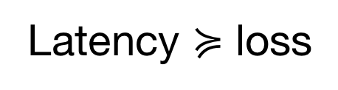
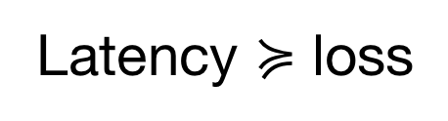
How to bridge the gap in the cellular edge?
State-of-the-art
Loss-latency tradeoff
Indistinguishability
No public verifiability
TLC
Bypassed
✓
✓
Latency $≽$ loss
⨯
⨯
Latency $≽$ loss
⨯
⨯
Notes:
Due to these challenges, we are unaware of any existing solutions that can handle the data loss and selfish charging simultaneously.
The legacy 4G/5G today and standardized ETSI edge architecture cannot eliminate the loss-induced gaps; they prioritize latency over loss.
They implicitly assumes the cellular operator is always trusted, and did not tackle the selfish charging.
So is there any solution that can solve them in the cellular edge? (pause)
Our answer is YES.
We devise TLC, a Trusted and Loss-tolerant Charging scheme for the 4G/5G cellular edge that achieves all the goals

Slide 12
How to bridge the gap in the cellular edge?
TLC: Trusted, Loss-tolerant Charging
Loss-latency tradeoff
Indistinguishability
No public verifiability
Latency friendliness
Loss-selfishness cancellation
Proof of charging
Notes:
TLC explores three key ideas
To bridge the gap, TLC’s key insight is to let the data loss and selfish claims cancel out each other.
This process is latency-friendly: It bypasses the loss-latency tradeoff when both are honest, and will not block or delay the data transfer.
By the end of the cancellation, a cryptographic Proof-of-Charging (PoC) is collaboratively constructed by the edge and the operator.
The PoC is publicly verifiable by an independent third party (e.g., FCC).

Slide 13

How TLC works: An overview
Public verifier(s)
PoC
PoC
Edge app
vendor
Cellular
operator
Mobile traffic
Local charging
data record
Local charging
data record
Loss-selfishness cancellation
Proof-of-Charging (PoC)
Proof-of-Charging (PoC)
Notes:
Here is TLC’s workflow at high level.
Within each bill/charging cycle, the edge and network deliver the traffic as today, and locally count the traffic
By the end of the charging cycle, they exchange their local charging records and negotiate the charging volume, during which the data loss is cancelled out
If the negotiation succeeds, they construct PoC collaboratively and keep it
If needed, they distribute PoC to independent 3rd party for verification.
In the following, I will show you the key ideas behind TLC

Slide 14
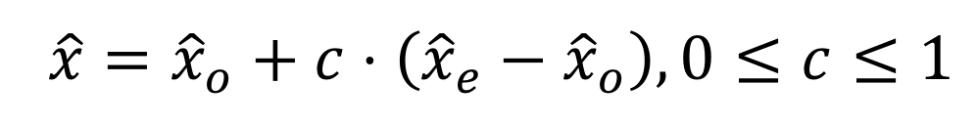
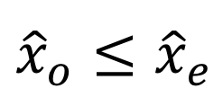


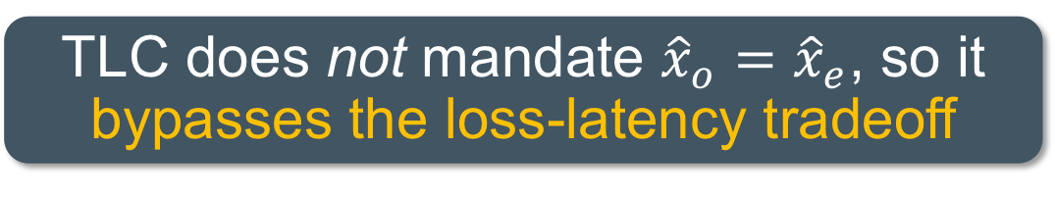

Loss-selfishness cancellation
A game-theoretical approach
Edge app vendor
Let edge and operator negotiate
Data loss asserts
Target charging volume
Report sent data
$${\hat{x}}_{e}$$
$${\hat{x}}_{o}≤{\hat{x}}_{e}$$
Data loss
$$\hat{x}$$
$$\hat{x}={\hat{x}}_{o}+c⋅\left({\hat{x}}_{e}−{\hat{x}}_{o}\right), 0≤c≤1$$
Received data
Lost data
TLC does not mandate ${\hat{x}}_{o}={\hat{x}}_{e}$, so it bypasses the loss-latency tradeoff
$${\hat{x}}_{o}$$
Report received data
Cellular operator
Notes:
The core of TLC is its loss-selfishness cancellation, a game-theoretical approach without delaying the edge traffic.
Different from legacy 4G/5G, TLC lets the edge and operator negotiate the data charging volume.
It asks the edge app vendor to report the data volume its edge nodes has sent, and asks the 4G/5G operator to report the data volume the edge nodes have received.
This is readily achievable today: In our paper, we have shown how to re-use existing 4G/5G mechanisms achieve so in a tamper-resilient way.
Due to data loss, the received data will be no more than the sent data.
Given sent/received volume, the operators may have diverse charging policies: Some may only charge received data, while others may also charge the lost data since the operators have consumed their resource for delivery.
We are neutral to these policies, and consider a general charging scheme.
Note that, we do not require synchronizing charging records, so it does not delay the edge traffic.

Slide 15


Loss-selfishness cancellation
A game-theoretical approach
Edge app vendor
Interplay between loss & selfishness:
Loss poses 3 constraints on selfishness
Report sent data
$${\hat{x}}_{e}$$
Selfish
under-charging
$$x_{e}$$
Data loss
$$\hat{x}$$
$$x_{o}$$
Selfish
over-charging
$${\hat{x}}_{o}$$
Report received data
Cellular operator
Notes:
Now consider the interplay between the data loss and selfish charging.
For their own benefits, a selfish cellular operator may over-claim received data, and the selfish edge may under-claim sent data.
However, the data loss poses three constraints over the possible selfish charging claims

Slide 16


Loss-selfishness cancellation
A game-theoretical approach
“Received data can’t exceed sent data!”
Edge app vendor
$$x_{o}$$
Interplay between loss & selfishness:
Loss poses 3 constraints on selfishness
  Bounded data charging
    How: Selfish charging + Cross check
$${\hat{x}}_{e}$$
Theorem: ${\hat{x}}_{o}≤x_{o},x_{e}≤{\hat{x}}_{e}$
Data loss
$$\hat{x}$$
$${\hat{x}}_{o}$$
Report received data
Cellular operator
Notes:
First, different from legacy 4G/5G today, any selfish charging claims in TLC will be provably bounded by the ground truth of sent/received data.
The reason is two-fold
For their own benefit, the selfish operator (edge) will not under(over)-claim the charging.
the operator and edge can cross-check each other’s record. If the operator’s received data is larger than edge’s sent data, the edge asserts the operator’s claim is selfish and thus rejects this proposal.

Slide 17
Loss-selfishness cancellation
A game-theoretical approach
Edge app vendor
Interplay between loss & selfishness:
Loss poses 3 constraints on selfishness
  Bounded data charging
  More selfish charging, less gap
Report sent data
$${\hat{x}}_{e}$$
$$x_{e}$$
Data loss
$$\hat{x}$$
$$x_{o}$$
$${\hat{x}}_{o}$$
Report received data
Cellular operator
Notes:
Second, if both are honest, charging gap is equal to data loss.
But if both are selfish, and edge’s claim is larger than network’s claim, the charging gap can be compressed by the selfish charging.
More selfish charging can result in less charging gap by data loss.

Slide 18

Loss-selfishness cancellation
A game-theoretical approach
“Received data can’t exceed sent data!”
Edge app vendor
Interplay between loss & selfishness:
Loss poses 3 constraints on selfishness
  Bounded data charging
  More selfish charging, less gap
  Detectable aggressive selfish charging
Report sent data
$${\hat{x}}_{e}$$
$$x_{o}$$
Data loss
$$\hat{x}$$
$$x_{e}$$
$${\hat{x}}_{o}$$
Report received data
Cellular operator
“Received data can’t exceed sent data!”
Notes:
Last, what if either edge or network is too selfish and aggressive, so that edge’s claim is smaller than network’s claim?
In this case, it will be immediately detected by both. The reason is that, the received data cannot exceed the sent data.
Upon detecting this signal, a rational edge/operator can take appropriate actions to countermeasure the other’s aggressive selfish charging.

Slide 19
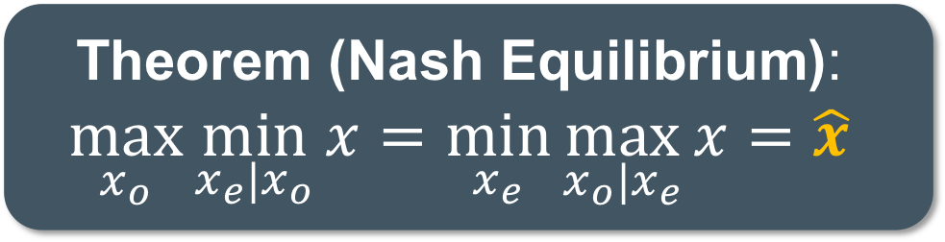
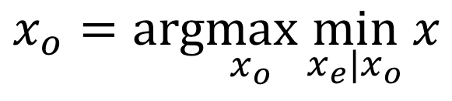
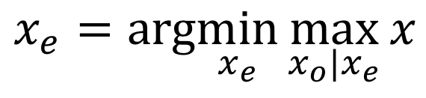
Loss-selfishness cancellation
A game-theoretical approach
Edge app vendor
To maximize their own benefits
  Cellular operator: maximin strategy
  Edge app vendor: minimax strategy
Report sent data
$${\hat{x}}_{e}$$
Selfish
under-charging
$$x_{o}=arg\max_{x_{o}}{\min_{x_{e}|x_{o}}{x}}$$
Data loss
$$\hat{x}$$
$$x_{e}=arg\min_{x_{e}}{\max_{x_{o}|x_{e}}{x}}$$
Selfish
over-charging
Theorem (Nash Equilibrium):
$$\max_{x_{o}}{\min_{x_{e}|x_{o}}{x}}=\min_{x_{e}}{\max_{x_{o}|x_{e}}{x}}=\hat{x}$$
$${\hat{x}}_{o}$$
Report received data
Cellular operator
Notes:
So with these constraints, what can network and edge do to maximize their own benefits?
Note that, this is actually a two-player, zero-sum game.
To maximize its charging, the cellular operator can use the classical maximin strategy:
For each possible selfish charging it claims, the network computes the worst-case charging by considering edge’s all possible selfish claim.
Then the edge reports that maximize its worst-case charging
Similarly, the minimize its payment, the edge can use the minimax strategy
Under the data loss’s constraints, we can prove that the operator and edge’s optimal strategies are coherent, and both result in the ground truth of target charging volume.
It means that, the unique Nash Equilibrium for zero-sum game exists and is equal to ground truth, and TLC will stop with it if both are selfish.
The details of negotiation and proof are available in our paper.

Slide 20


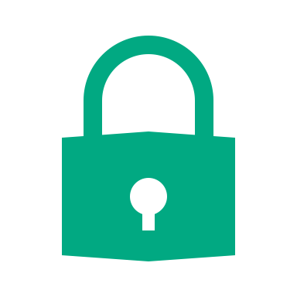


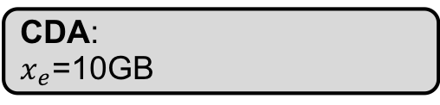
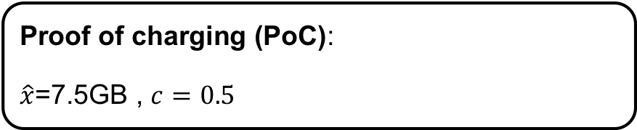
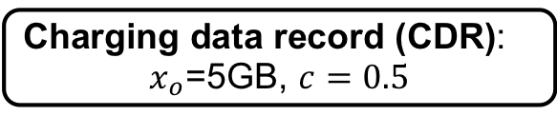

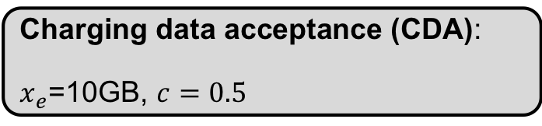
Proof-of-Charging (PoC)
Cryptographic, publicly verifiable charging receipt
Private
Private
Public
Public
Public key sharing
Charging data record (CDR):
$x_{o}$=5GB, $c=0.5$
PoC
PoC
Charging data acceptance (CDA):
$x_{e}$=10GB, $c=0.5$
CDR: $x_{o}$=5GB
Proof of charging (PoC):
$\hat{x}$=7.5GB , $c=0.5$
CDA:
$x_{e}$=10GB
CDR: $x_{o}$=5GB
Notes:
Now let’s look at how to convert this theoretical framework to a publicly verifiable protocol.
The key idea is to mutually sign the charging records during the negotiation.
In this example, the operator initiates the negotiation by sending its local CDR.
When sending its local record, it should digitally sign their records with private keys.
On recv operator’s CDR, the edge obtains operator’s charging claims with public key, copies the original signed message into its response, and further signs it together with its own charging record.
Upon receiving the edge’s record, the operator further signs it and include the negotiated volume.
This would result in a mutually signed proof-of-charging message.
Such PoC can only be generated if and only if edge and network finish the negotiation,.

Slide 21
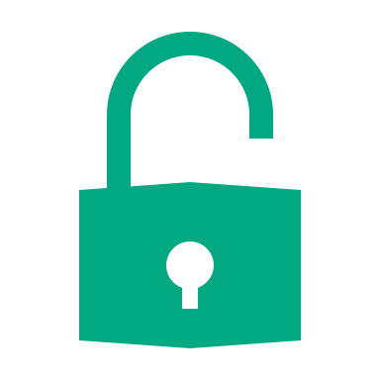




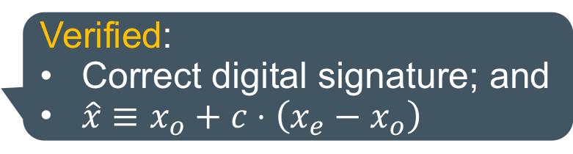
Proof-of-Charging (PoC)
Cryptographic, publicly verifiable charging receipt
Private
Private
Public
Public
PoC
PoC
Proof of charging (PoC):
$\hat{x}$=7.5GB , $c=0.5$
CDA:
$x_{e}$=10GB
CDR: $x_{o}$=5GB
Verified:
Correct digital signature; and
$\hat{x}≡x_{o}+c⋅\left(x_{e}−x_{o}\right)$
Public
Public
Notes:
For the independent 3rd party, it can easily verify this PoC with edge/network’s public keys only.
It first verifies the signature; and then replay the charging volumes and compare with the negotiate volume

Slide 22
More in the paper
Economic deployment incentives for all participants
Incremental deployability in 4G/5G edge
Tamper-resilient charging records with hardware-level protection
Tackling malicious manipulations of TLC
Extensions to generic mobile data charging
…
Notes:
In our paper, we have discussed more practical aspects of TLC, such as
How to motivate all participants to deploy TLC with economic incentives
How to incrementally deploy TLC in 4G/5G edge
How to leverage 4G/5G domain knowledge to construct hardware-level tamper-resilient charging records
How to tackle malicious manipulations of TLC
How to extend TLC to generic mobile data charging
If you are interested, please read our paper.

Slide 23
Implementation and prototype
Carrier-grade cellular networks
  Qualcomm LTE small cells + OpenEPC
Various commodity edge devices
  HPE Edgeline GL20, Pixel 2 XL, S7 Edge
Edge applications from real use cases
  WebCam surveillance, VR, online gaming
Notes:
We have prototyped TLC with commercial edge devices and carrier-grade cellular networks, using OpenEPC and Qualcomm small cells.
We have tested TLC under various edge applications, such as video surveillance, edge-based VR, and online mobile gaming.

Slide 24
Evaluation: Can TLC bridge the charging gap?
Legacy 4G/5G
TLC-optimal
YES! Compared to legacy 4G/5G
  80.2% in WebCam, 87.5% in VR, and 47.06% in online gaming
  More traffic, intermittent wireless or congestion, more gap reduction
  Provably bounded data charging
WebCam (RTSP, UL)
WebCam (UDP, UL)
VR (GVSP, DL)
Gaming (UDP, DL)
Notes:
Compared with the legacy 4G/5G, TLC reduces the average gap by 80.2% in WebCam streaming, 87.5% in edge-based VR, and 47.06% in the online gaming.
Higher charging gap reductions will be observed if the edge app‘s traffic is more intensive, the wireless is more intermittent, or the network is more congested.
As we have seen, it also guarantees bounded charging compared to 4G/5G.

Slide 25
Evaluation: How much overhead does TLC incur?
Negligible extra latency for the edge traffic
  In the charging cycle: No traffic blocking (delay)
  After the charging cycle: 2-RTT negotiation
Marginal signaling overhead: In each charging cycle
  3 additional signaling messages
  1,393 additional bytes in total
Scalable public verification
  A single HP Z840 workstation can verify 230K PoCs/hour
Notes:
In eliminating the charging gap, TLC still retains low system overhead
Negligible extra latency for the edge traffic
Marginal signaling overhead
Scalable public verification

Slide 26
Conclusion
No free lunch for the low-latency cellular edge networking
  The charging gap can arise from data loss and selfish charging
TLC: Bridge the charging gap with game theory and cryptography
  Provable correctness, latency friendliness, and public verifiability
An initial step toward trusted, transparent, & verifiable cellular edge
  More academic and industrial efforts are needed
Notes:
In summary, we show that there is no free lunch low-latency cellular edge traffic
The charging gap can arise from data loss and selfish charging
To bridge the gap, we have devised a TLC using game theory and cryptography
Provable correctness, latency friendliness, and public verifiability
TLC is an initial attempt toward enhancing the trust between the cellular operators and edge app vendors.
For decades, the cellular networks largely follow the network-centric design, leaving limited transparency to their users.
Without cooperation, it is hard for the cellular operators and users to fully trust each other.
We wish TLC could call the academia and industry’s attention for this issue, and stimulate more research, engineering and standardization efforts toward trusted, verifiable cellular edge services.

Slide 27
Thank you!
Questions?
Notes:
Thanks for listening. I am happy to answer your questions.

